Slide 1
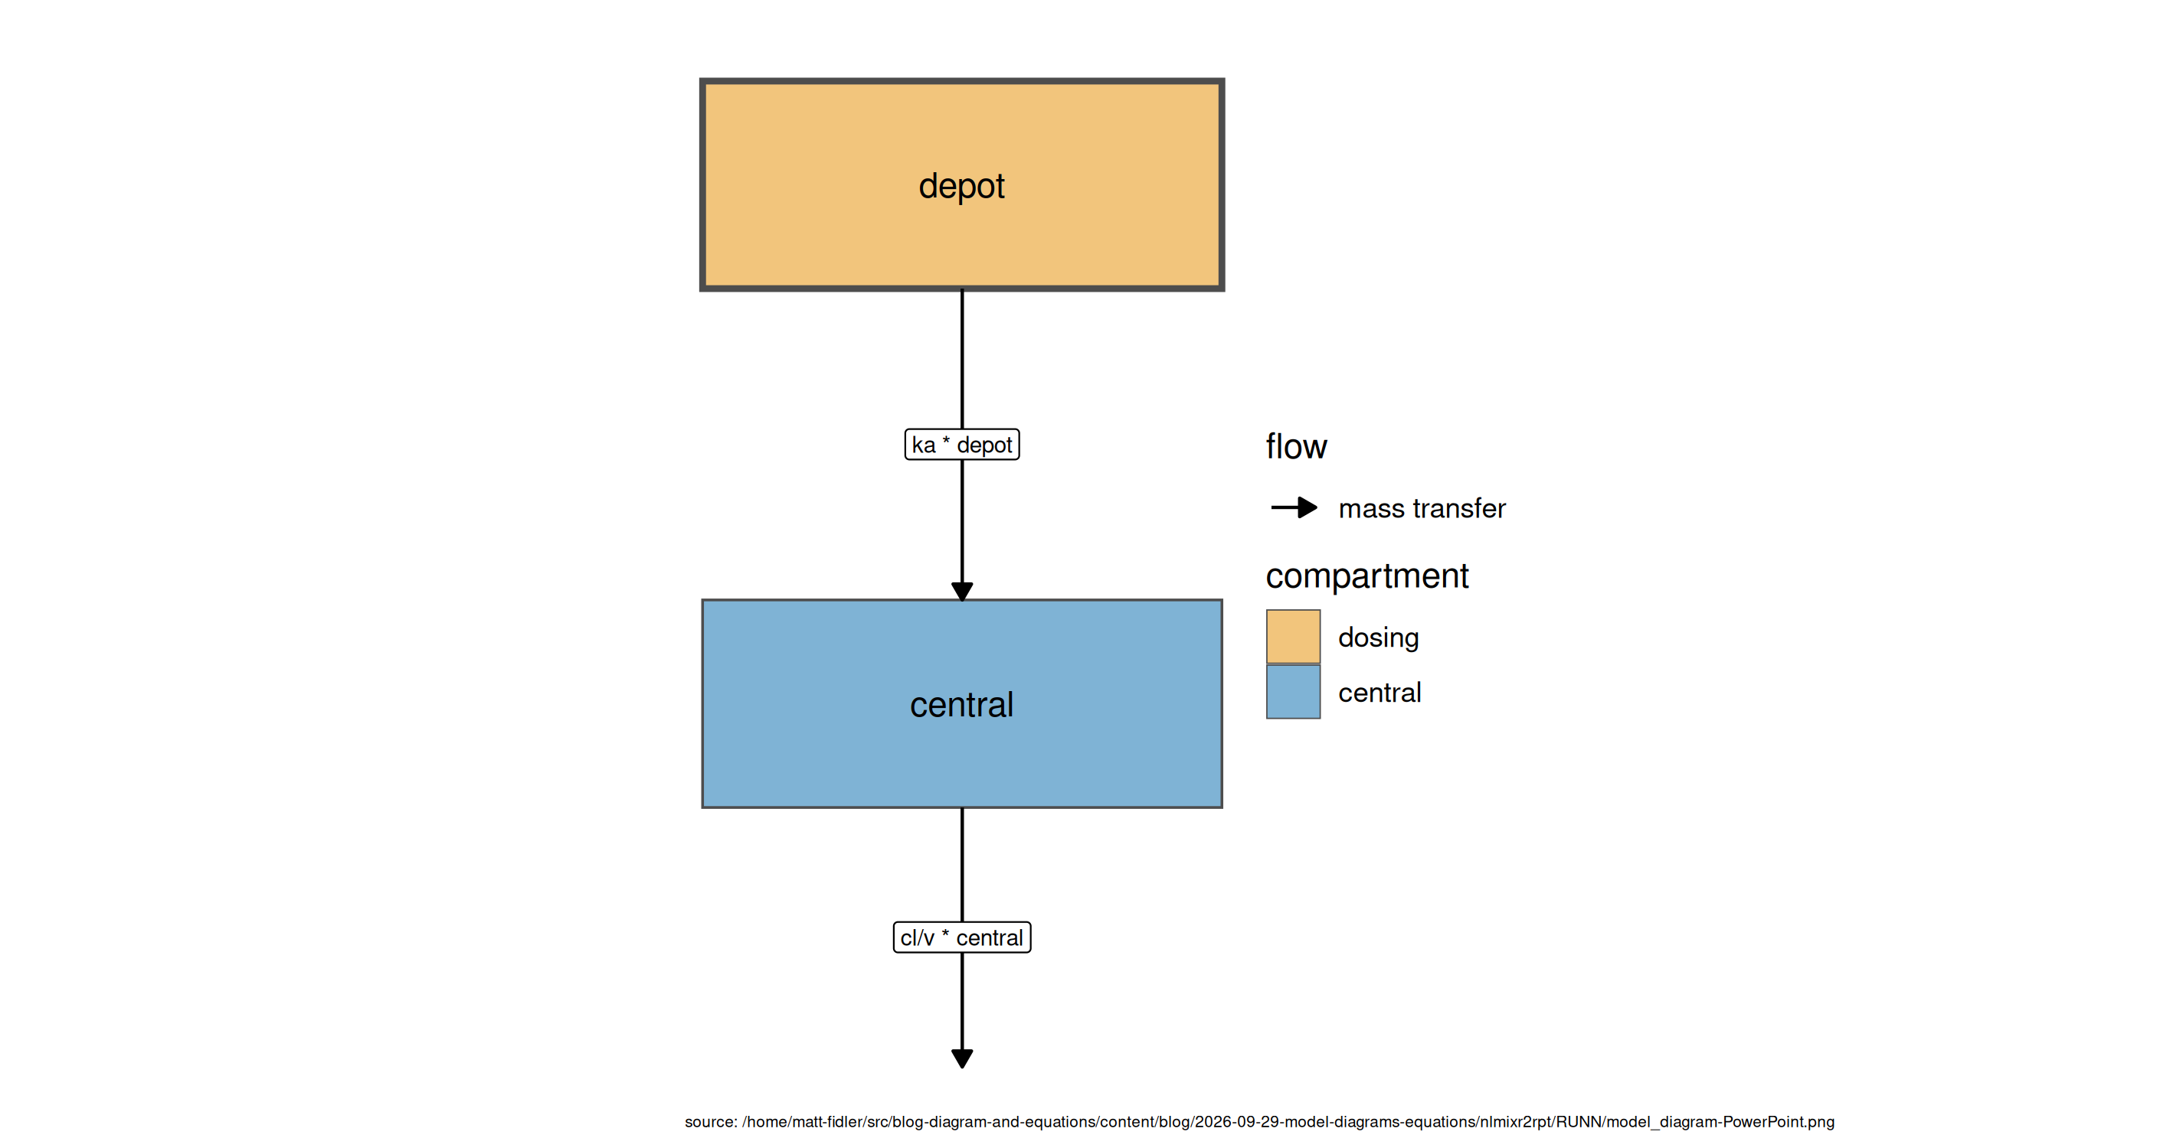
Model structure

Slide 2
Model equations
$$ka=exp⁡(tka+eta.ka)$$
$$cl=exp⁡(tcl+eta.cl)$$
$$v=exp⁡(tv+eta.v)$$
$$\frac{d depot}{dt}=−ka×depot$$
$$\frac{d central}{dt}=ka×depot−\frac{cl}{v}×central$$
$$cp=\frac{central}{v}$$
$$cp∼add(add.sd)$$

Slide 3
Parameter Estimates
Parameter | Est. | SE | %RSE | Back-transformed(95%CI) | BSV(CV%) | Shrink(SD)%
tka | 0.461 | 0.192 | 41.6 | 1.59 (1.09, 2.31) | 71.5 | -0.0769>
tcl | 1.01 | 0.0789 | 7.80 | 2.75 (2.36, 3.21) | 26.2 | 3.89<
tv | 3.45 | 0.0453 | 1.31 | 31.6 (28.9, 34.5) | 14.4 | 11.2<
add.sd | 0.697 | 0.0472 | 6.77 | 0.697 (0.604, 0.789)

Slide 4
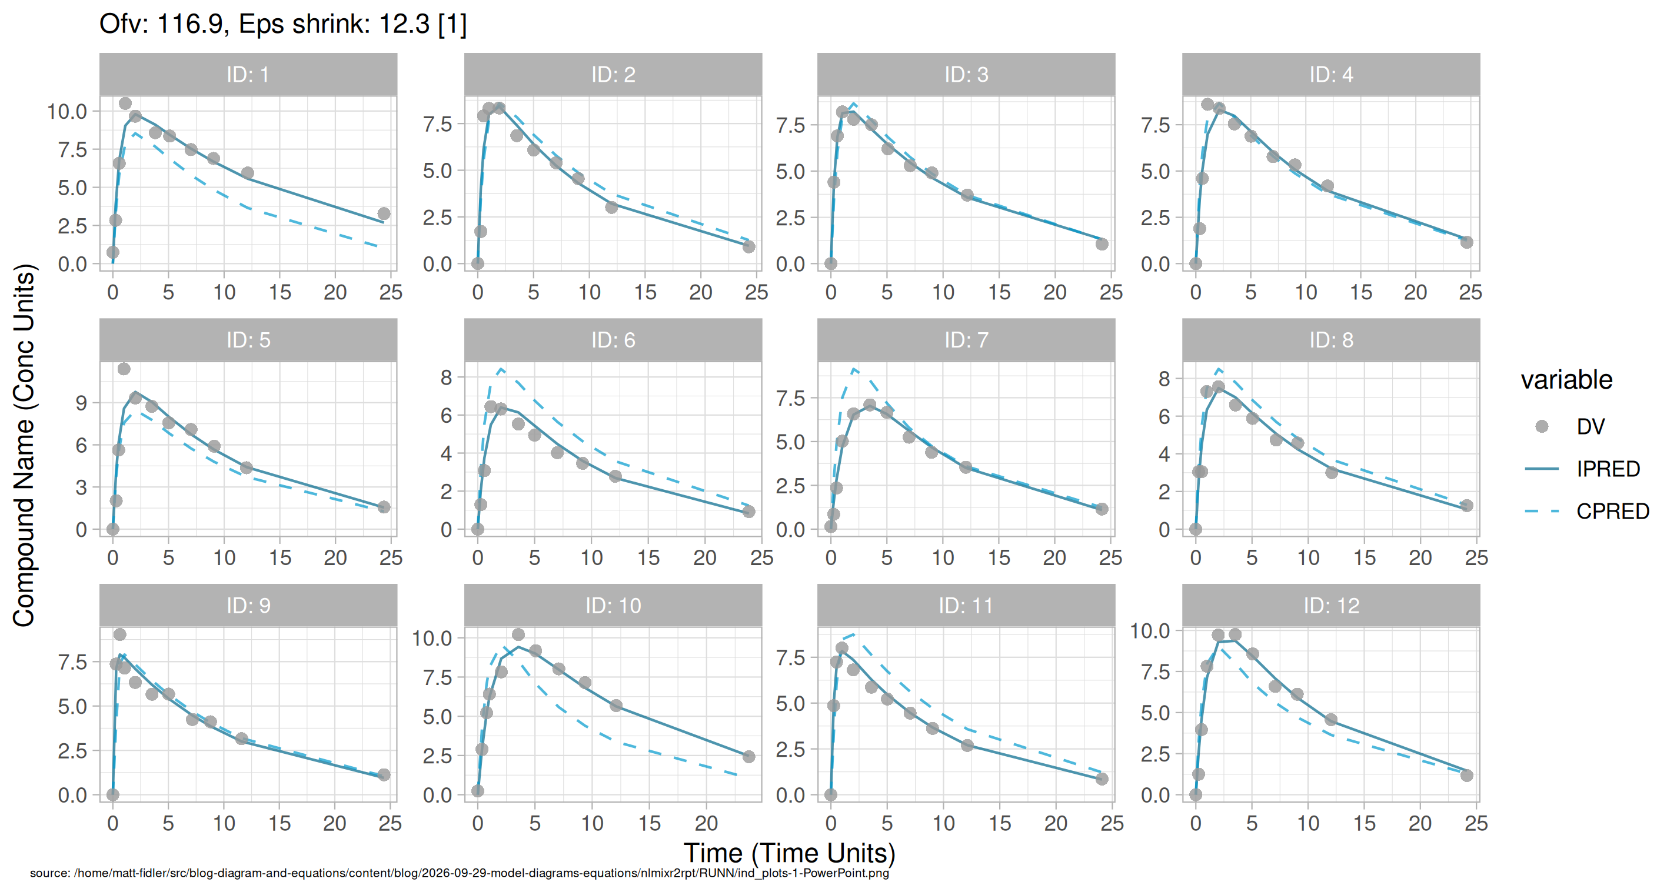
Individual and population prediction overlay

Slide 5
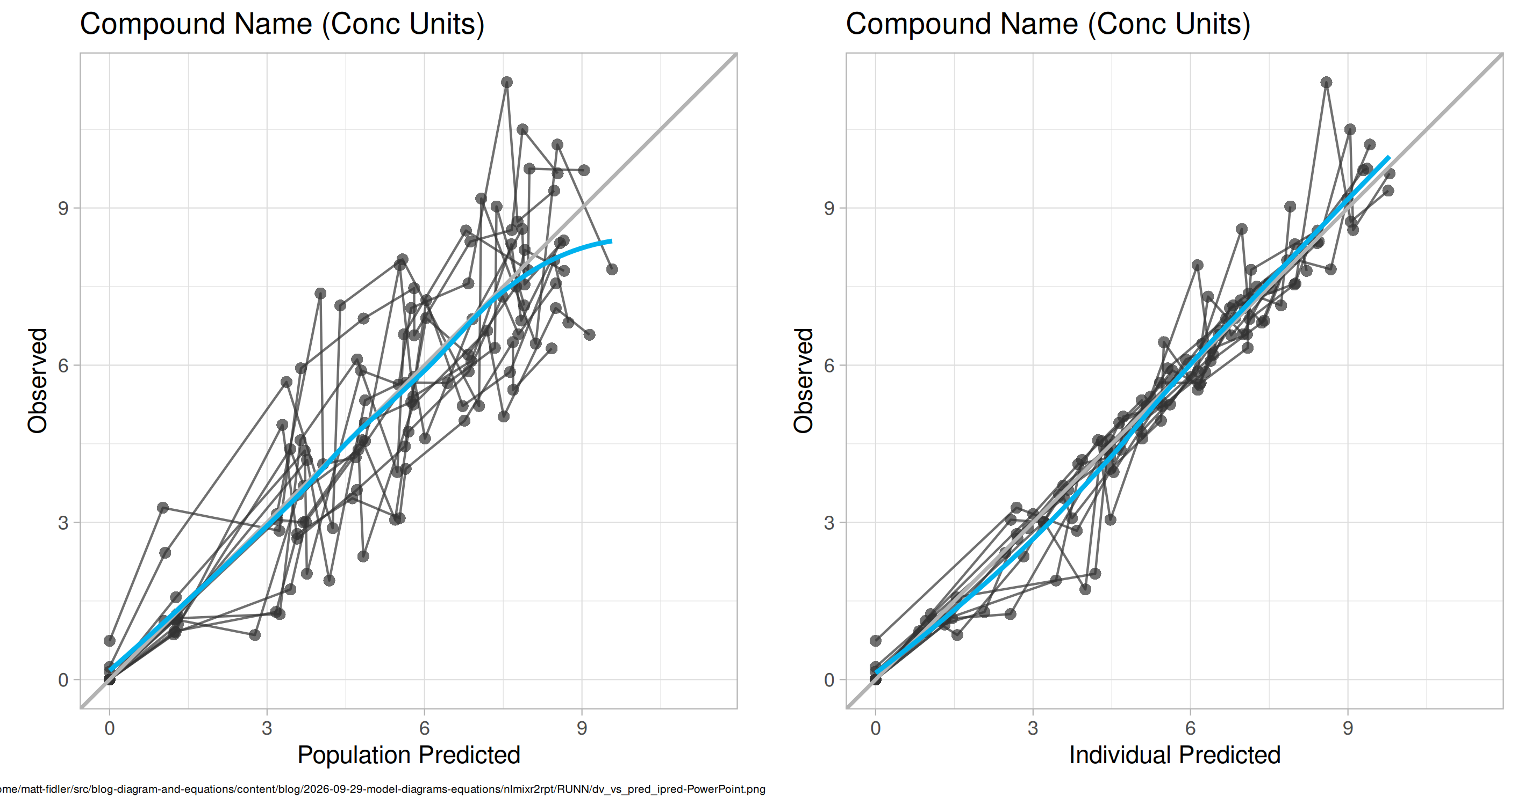
Observed vs Predicted

Slide 6
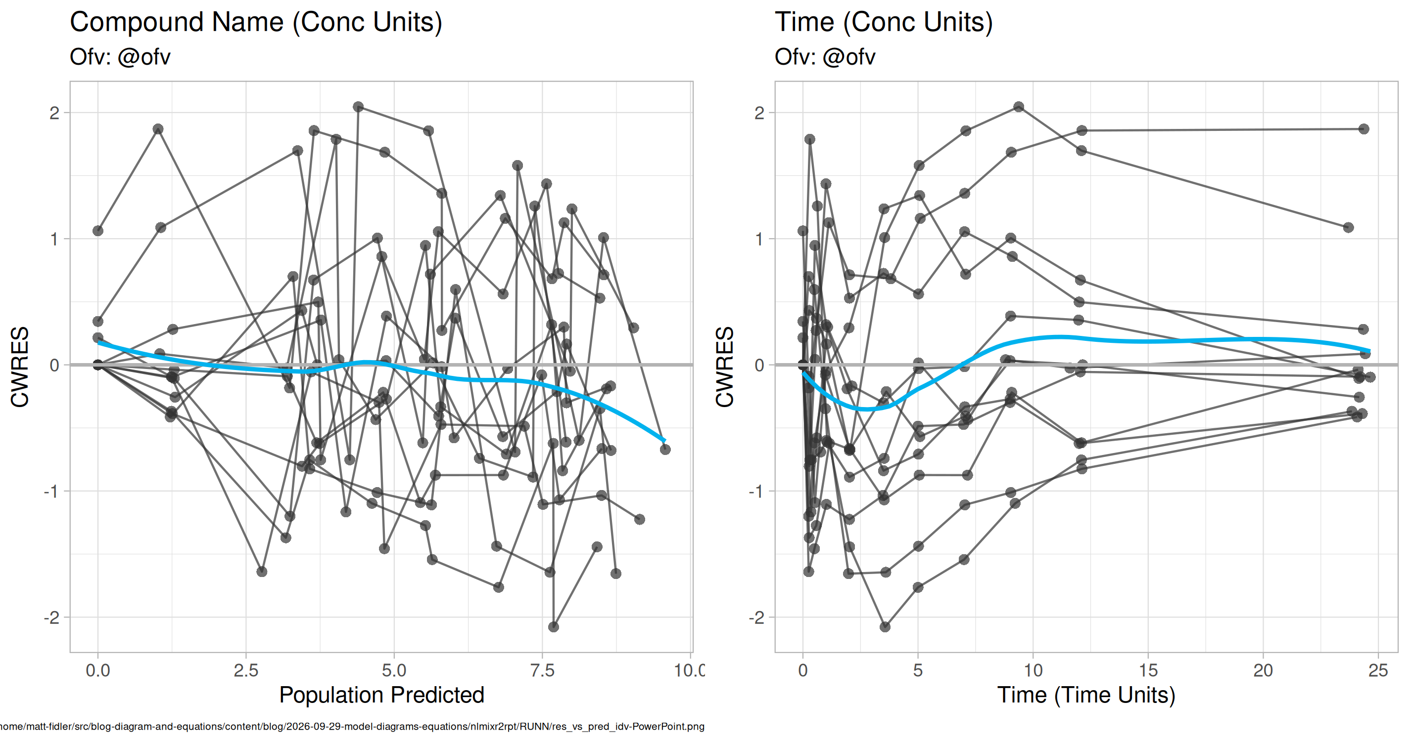
CWRES vs Pred and Time

Slide 7
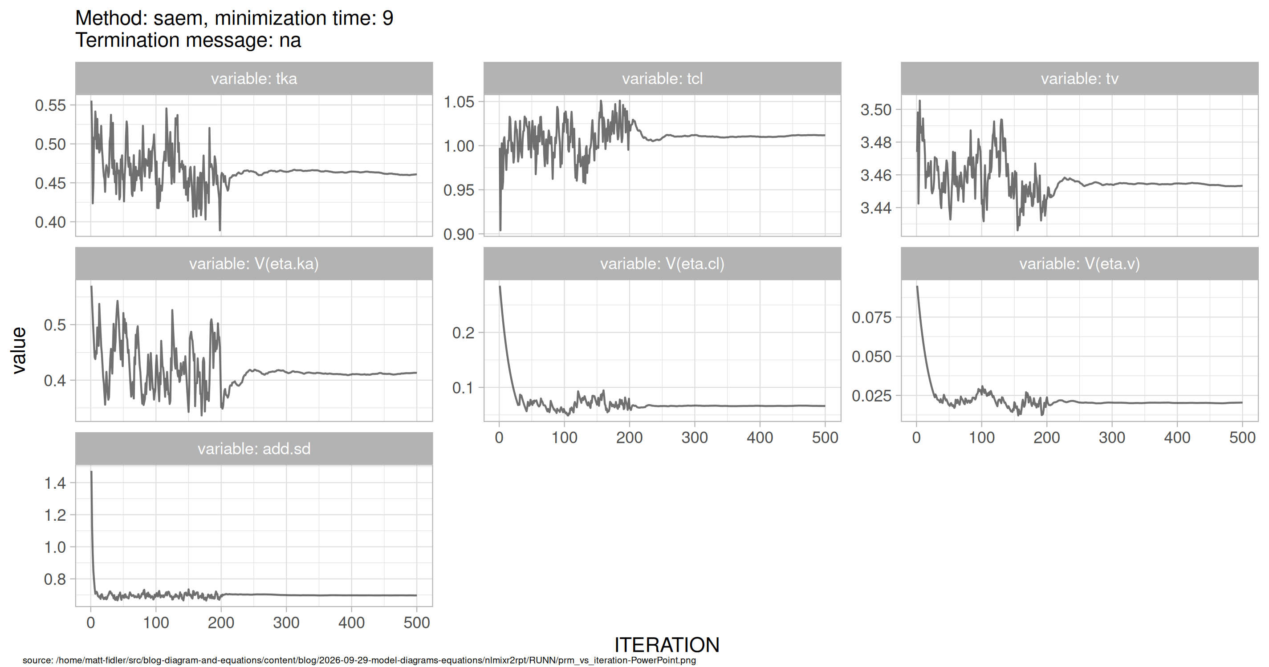
SAEM Stabilization

